Slide 1


Slide 2
I say A “front-end build pipeline” – You say WAT!?
Chris Klug
Novatrox | chris.klug@novatrox.se
@ZeroKoll | http://chris.59north.com

Slide 3




Who am I?

Slide 4
“Front-end build pipelines”

Slide 5
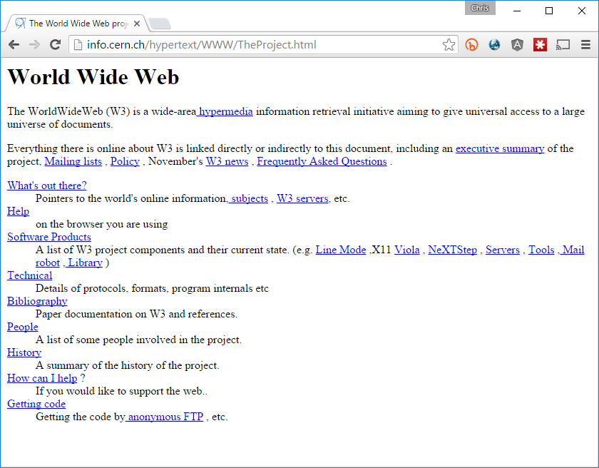
1991
Notes:
1991 CERN

Slide 6
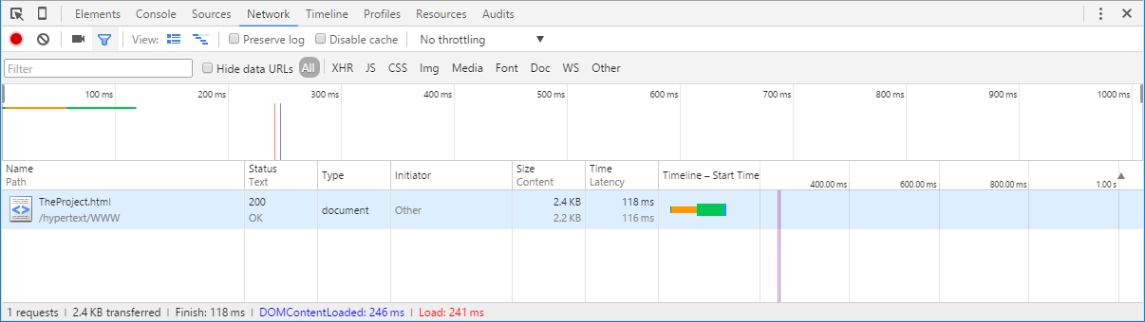

Slide 7
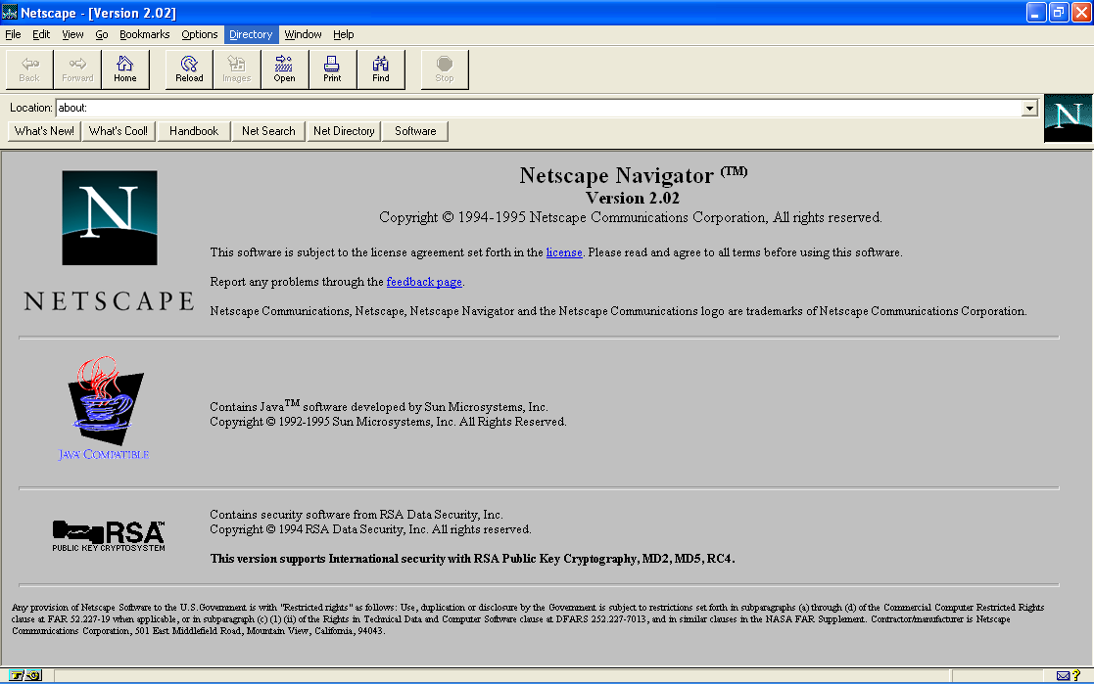

1995
Notes:
JavaScript was originally developed in 10 days in May 1995 by Brendan Eich for Netscape
Codename: Mocha
Official: LiveScript

Slide 8
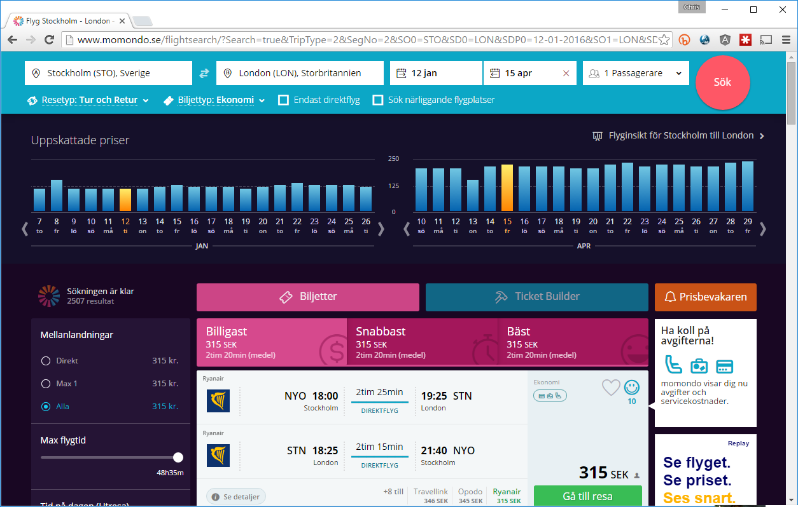
2015

Slide 9
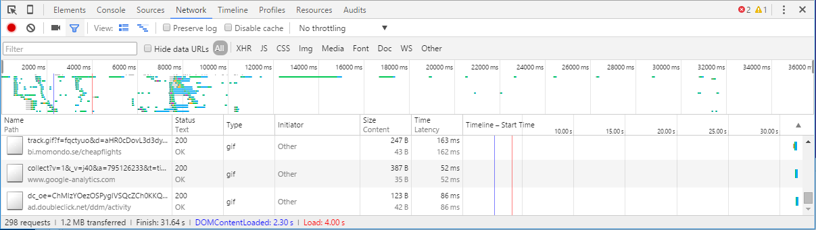

Slide 10



6/17
6/10
13/17
13/17
Connections per Host / Max Connections | http://www.browserscope.org/
Notes:
Connections per hostname/Max connections

Slide 11


Slide 13

40 KB in 1985
Notes:
Super Mario, the entire game, was 40 kilobyte

Slide 14

163 KB in 2016
Notes:
This image is 163 KB

Slide 15

.css
.min.css
.min.css.zip
118 KB
98 KB
17 KB
Based on v. 3.1.1

Slide 16
Is perf and bandwidth the only reasons to do this?

Slide 17
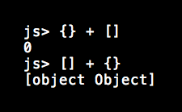

Slide 18







and then some...

Slide 19


Slide 20


Slide 21


Slide 22
> npm install Package-of-Choice
or
>npm init
>npm install Package-of-Choice --save-dev

Slide 23
>npm install

Slide 24
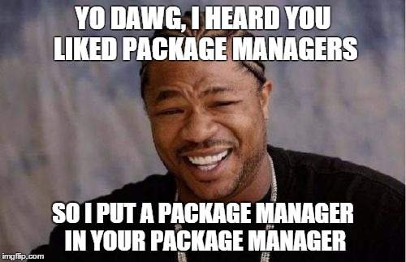

Slide 25



Slide 26
>npm install –g Package-Manager-of-Choice
...
>pmoc init
>pmoc install Package-of-Choice --save-dev

Slide 27
>pmoc install

Slide 28





etc...

Slide 29
>npm install –g Task-Runner-of-Choice[-CLI]
...
>npm init
>npm install Task-Runner-of-Choice --save-dev
...create task runner config...
>troc Task-of-Choice

Slide 30


Slide 31
Gulp Gotchas
Gulp runs tasks in parallel by default
Task-dependencies and merge-stream etc
gulp-tap
Let’s you ”hook into” Gulp streams

Slide 32
General Gotchas
Dependency Injection & minification
Angular: ng-annotate / gulp-ng-annotate
Ordering of files vs module loader
Intermediary ”build” output can be helpful
Visual Studio TS transpile vs. TSC
Resolves dependencies diferently
Pipeline needs to run during CI/CD
http://chris.59north.com/
Cache busting

Slide 33
Potential Tweaks to Flow
Configurable resource prefix
<script src=“[PREFIX]/Scripts/App.js"></script>
<script src=“~/Scripts/App.js"></script>
<script src=“http://static.foo.com/Scripts/App.js"></script>
<script src=“http://client.cdnservice.com/Scripts/App.js"></script>
System.config({ baseURL: “[PREFIX]/” });
Gzip
TypeScript testing and linting
JavaScript testing and linting

Slide 34
Thanks for listening!
Don’t miss out! Kurs om OWIN & Project Katana
http://bit.ly/understanding-owin

